Slide 1

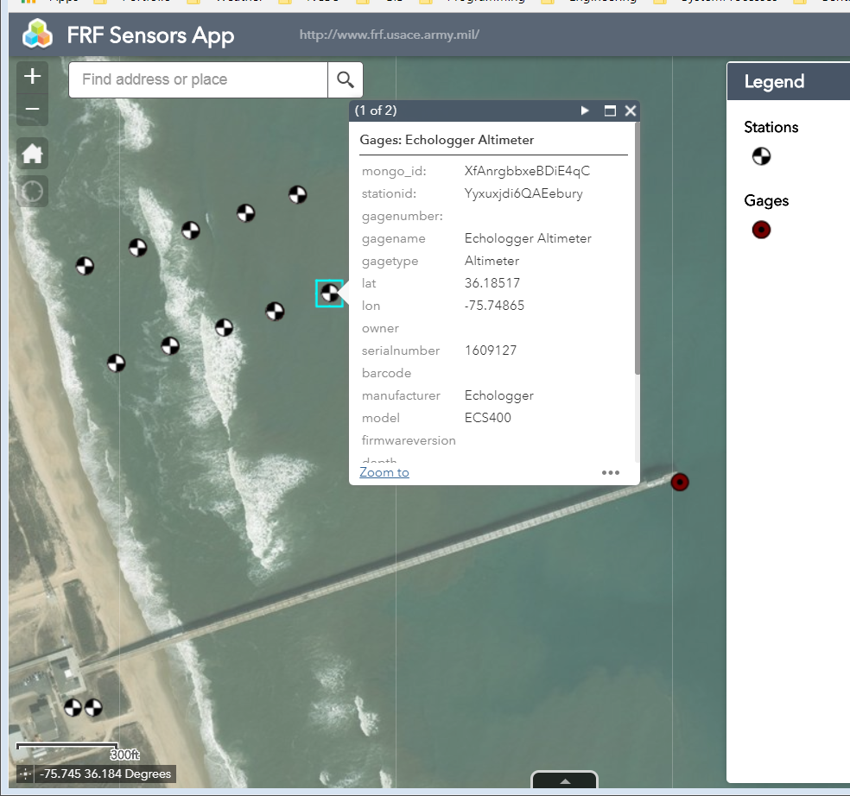
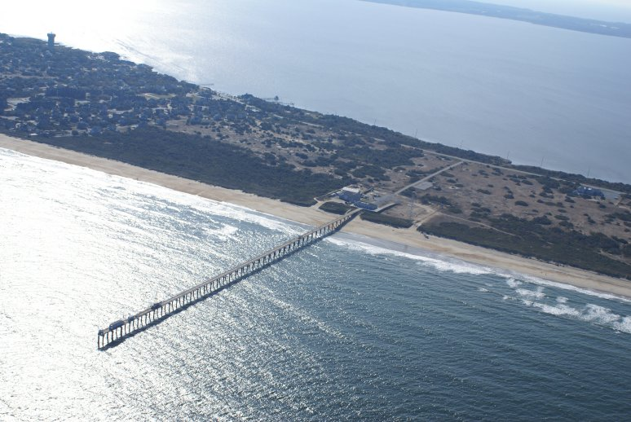
https://twitter.com/Rainmaker1973/status/979697624302411776
Bridging MongoDB to PostgreSQL
A Data Analysis and Migration Project
Paul Schrum, NC State MGIST ptschrum@ncsu.edu 11 May 2018
Background
The US Army Corps of Engineers' Field Research Facility in Duck, North Carolina (FRF), maintains multiple sensor stations at various locations in the Atlantic Ocean. To keep track of important information about these sensors, FRF maintains a database with all essential information about stations, sensors, and service times in a MongoDB database.
Methods
The data dump from MongoDB is a text file in which every line is a single JavaScript Object Notation (JSON) entity, and each JSON entity represents one MongoDB document. Step 1 was to analyze the JSON data and determine how to represent this data in an RDBMS. Analysis revealed the following Entity Relationship Diagram.
The second step was to implement the bridge, which is Python code using arcpy to read the text file, parse the data, and write the values to the PostgreSQL database such that it fits the ER Diagram, including storing of the spatial coordinates so that the points may displayed on a web map.
The third step is to implement the bridge in Python code. The Python module reads the MongoDB data dump, convert it to SQL, and update the three tables (see Diagram 1) as needed.
A web map of the region was created, and the web application was created for the same area. Widgets were added allowing FRF personnel to upload new data to the existing database. They may still query their data using SQL if they like. Other map-oriented queries were provided.
The Problem
The Field Research Facility has a database of all their stations and the sensors on those stations, including active/inactive dates and times. The database is implemented as Document Database (MongoDB), which is a relatively new database technology. Importantly, performing queries on Document Databases requires new skillsets. FRF staff would like to have the data available for running queries using the Structured Query Language (SQL).
The Solution
To provide FRF personnel with the ability to query their data using SQL, the data must be stored in a Relational Database Management System (RDBMS) such as PostgreSQL. To accomplish this, the data must be migrated from MongoDB to a PostgreSQL RDBMS. This project accomplishes this migration.
The Challenge
Migrating the data from MongoDB to PostgreSQL is a challenging process because the data configuration of a Document Database is fundamentally different from the "data shape" of a RDBMS. The first challenge was to analyze the data exported from MongoDB and determine what should be the appropriate Entity Relation Diagram for the RDBMS.
fc_stations
-----------------------
mongo_id (pk)
StationName
Lat
Long
projectName
waterDepth
fc_gages
----------------------
mongo_id (pk)
gageModelName
Station_id (fk)
assigned
comments
createdAt
title
1
∞
Figure 2: Screen Capture of the Web Application showing stations and gages near the Field Research Facility Office in Duck, NC.
Diagram 1: Entity Relation Diagram for the RDMBS implementation of the database.
Discussion
This project is primarily a software development project with Web Mapping and Web Application capabilities added on after the software was developed.
The Python module was developed with two objectives in mind: 1) Ease of operational use – the system administrator's task is as simple as possible, and
2) Ease of extending capabilities – FRF staff who know some Python may extend capabilities easily.
Results
Using ESRI's arcpy module, Python code was developed which reads the .json input files then writes those values to the PostgreSQL database by using an InsertCursor on the map. Whenever FRF personnel need to update wishes to update the PostgreSQL database, all that is necessary is to run a command at a standard windows Command Line prompt.
Once the data has been bridged to populate the PostgreSQL database, the public may view the stations and gages on a Web Map and download the data as CSV files via a Web App.
A screenshot of the Web App is shown in Figure 2.
Conclusion
The primary objectives were met and the bridge works satisfactorily. In future work FRF personnel may add other tables to this system, including making the gage readings available.
Acknowledgements
Thanks to the Field Research Facility staff for their assistance with this project. Figure 1 is provided by the Field Research Facility. The background image is from Wikipedia and is in the public domain.
Figure 1: Photograph of the Field Research Facility in Duck, North Carolina.

